Slide 1

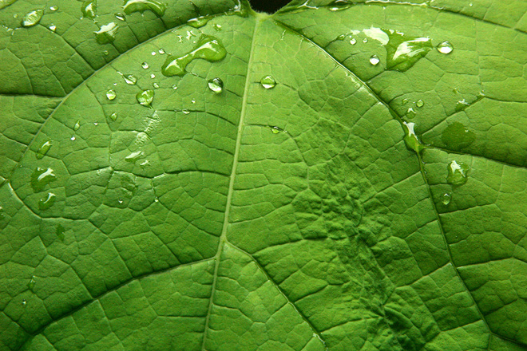
Green SDn: AN approach for power optimization
Gökcan Çantalı, 06.12.2016

Slide 2
SDN (Software-defined networking)
An emerging paradigm which is based on the decoupling of data plane and control plane
Many data centers have started to
switch to SDN
Easier to program the physical network
A simple overview of SDN architecture [1]

Slide 3

WHY is it important to reduce power ?
More power means more energy consumption:
Global warming
Depletion of natural resources
Cost

Slide 4
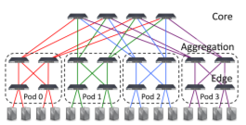
Previous Works
ElasticTree [2]
Formal Model: Mixed-Integer Linear Programming (MILP)
Low-Scalability
Optimum value
Greedy Bin-Packing: Greedy flow assignment
Medium-Scalability
Near-Optimum value
Topology-Aware Heuristic: Splitting flows, only applied to FatTree architecture
High-Scalability
Good value (But not optimum)
Achieves around 40% energy saving compared to the fully powered network.
FatTree Architecture used in [2]

Slide 5
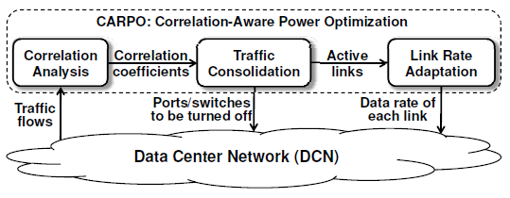
CARPO [3]
First approach = MILP -> Not scalable due to high complexity
Second approach = Correlation-Aware Consolidation Algorithm
Lower complexity, thus higher scalability
Correlation Analysis, Traffic Consolidation, Link Rate Adaptation
Outperforms ElasticTree by 19.6%
The proposed CARPO framework in [3]

Slide 6
Bolla et al. [4]
Specific to SDN environment
Based on pre-computing the paths between nodes and choosing the ones which can satisfy the demand and appear many times in the paths
Energy saving up to 80% compared to the fully functional network
The network topology that is used for the tests in [4]

Slide 7
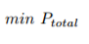
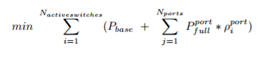
OUR MODEL
Objective Function
Objective Function (In a formal manner)

Slide 8
Decision Variables
Whether or not a switch is active (Edge Switch, Aggregate Switch, Core Switch)
S_{e} = {0,1} for all Edge Switch e
S_{a} = {0,1} for all Aggregate Switch a
S_{c} = {0,1} for all Core Switch c
The flow on each link (fl)
Constants
Pbase, base power of an active switch
Pport, power of a fully utilized port
Input parameters
The number of ports in a switch (k)
Traffic requirement matrix ([r_{ij}])
The bandwidth capacity of each link (Cl)
Constraints
Link Capacity (fl < Cl for all link l )
Flow Preservation

Slide 9

OUR METHOD
An example of a simulated annealing search. [5]
Simulated Annealing is used solution
Neighborhood structure defines neighbor states between which the number of active switches is only one.
Initial temperature and cooling rate are parametrized
We have used FatTree architecture
Python language is used for the implementation

Slide 10
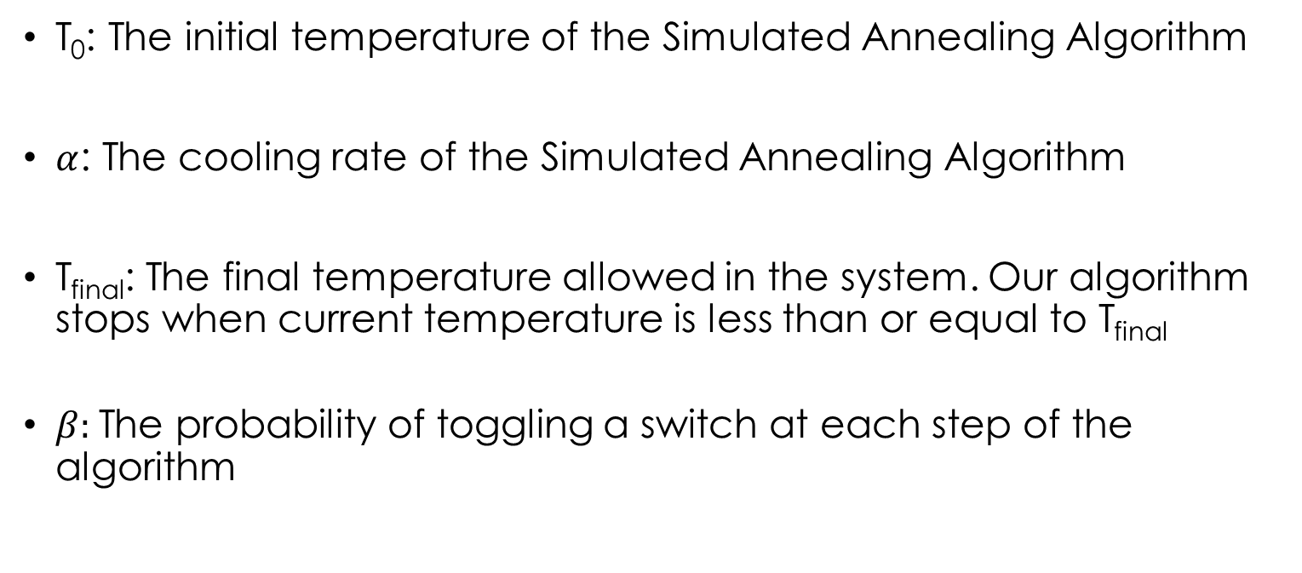
System parameters
T₀: The initial temperature of the Simulated Annealing Algorithm
$α$: The cooling rate of the Simulated Annealing Algorithm
T_{final}: The final temperature allowed in the system. Our algorithm stops when current temperature is less than or equal to T_{final}
$β:$The probability of toggling a switch at each step of the algorithm

Slide 11
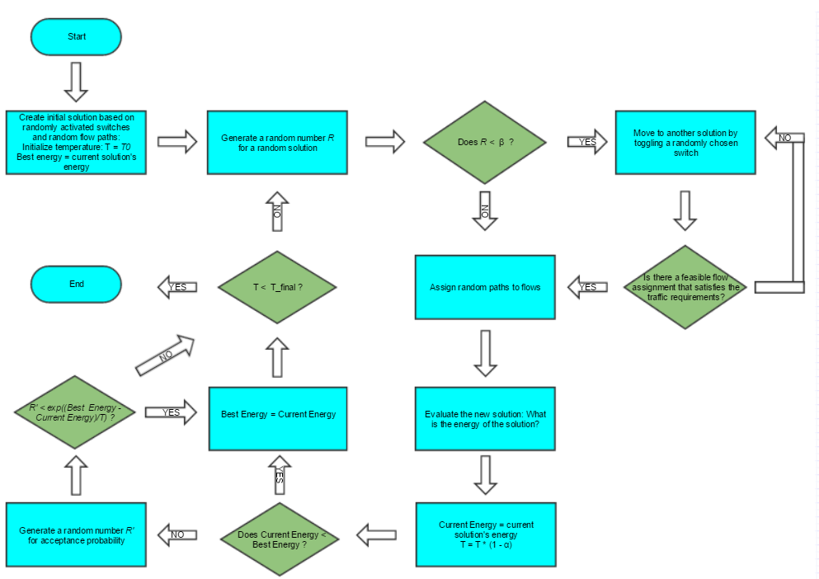
The flowchart of our algorithm

Slide 12
Deciding the quality of solution
Two different approaches have been used
Comparison: We compare the optimum power consumption value evaluated by our algorithm to the optimum value evaluated by Open Shortest Path First (OSPF)[6] algorithm.
Statistical Quality Measurement: We generate a large set of random solutions, compute the mean & standard deviation of the solution set and analyze how far our algorithm’s results are to the random solutions

Slide 13
Experiment design
Two Phase experiment design is chosen
First Phase: There are more parameters, few levels
Second Phase: There are less paremeters with many levels

Slide 14
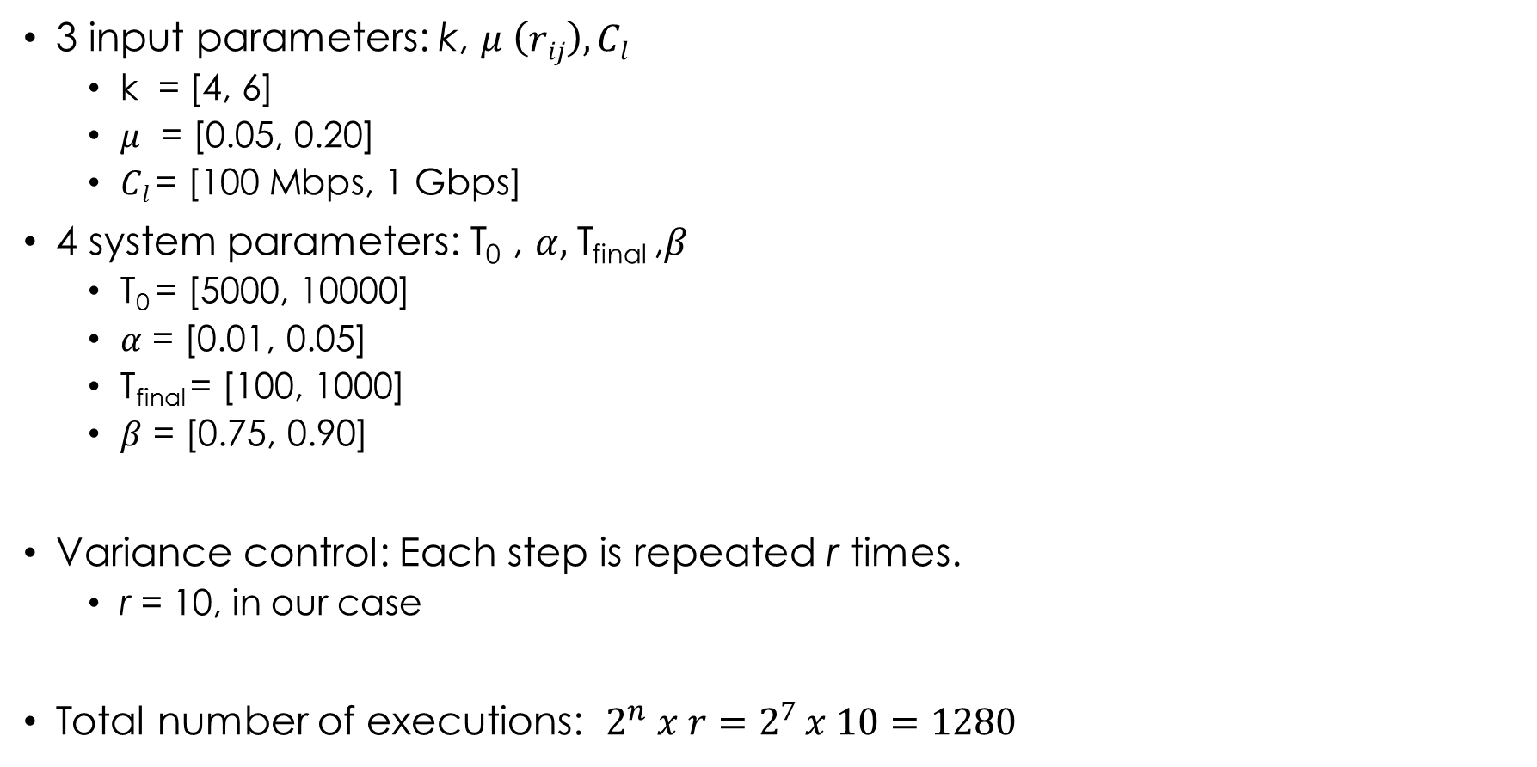
PHASE I
3 input parameters: k, $μ \left(rij\right), Cl$
k = [4, 6]
$μ$ = [0.05, 0.20]
$Cl$= [100 Mbps, 1 Gbps]
4 system parameters: T₀ , $α,$T_{final} ,$β$
T₀ = [5000, 10000]
$α$ = [0.01, 0.05]
T_{final} = [100, 1000]
$β$ = [0.75, 0.90]
Variance control: Each step is repeated r times.
r = 10, in our case
Total number of executions: $2^{n} x r=$ $2^{7 }x 10=1280$

Slide 15
Parameters |  | Our Solution |  | OSPF |  | Statistical Quality Measurement
K = 4 N = 16 | Uniform & sparse Г_{ij} | Max | 16709.2050 | Max | 16709.2050 | Mean | 23855.1266
 |  | Avg | 16088.1890 | Avg | 16088.1890
 |  |  |  |  |  | Std. Dev. | 1071.63956
 |  | Min | 13516.8000 | Min | 13516.8000
 | Uniform & dense Г_{ij} | Max | 17986.2550 | Max | 17986.2550 | Mean | 26575.3548
 |  | Avg | 17800.2375 | Avg | 17800.2375
 |  |  |  |  |  | Std. Dev. | 1398.94453
 |  | Min | 17572.5300 | Min | 17572.5300
K = 6 N = 54 | Uniform & sparse Г_{ij} | Max | 35590.6400 | Max | 35929.9450 | Mean | 53791.9853
 |  | Avg | 34653.8370 | Avg | 35718.5370
 |  |  |  |  |  | Std. Dev. | 2071.68987
 |  | Min | 34236.7450 | Min | 35419.7450
 | Uniform & dense Г_{ij} | Max | 36026.6150 | Max | 37209.6150 | Mean | 55239.9109
 |  | Avg | 35712.1240 | Avg | 36895.1240
 |  |  |  |  |  | Std. Dev. | 2702.93754
 |  | Min | 35479.3100 | Min | 36662.310
The result of the Phase I experiments when C_{l} = 100Mbps

Slide 16
Parameters |  | Our Solution |  | OSPF |  | Statistical Quality Measurement
K = 4 N = 16 | Uniform & sparse Г_{ij} | Max | 15396.2056 | Max | 15396.2056 | Mean | 22422.8743
 |  | Avg | 14917.0499 | Avg | 14917.0499
 |  |  |  |  |  | Std. Dev. | 1344.71398
 |  | Min | 14202.8375 | Min | 14202.8375
 | Uniform & dense Г_{ij} | Max | 15430.3976 | Max | 15430.3976 | Mean | 22809.6553
 |  | Avg | 15421.5266 | Avg | 15421.5266
 |  |  |  |  |  | Std. Dev. | 1108.34388
 |  | Min | 15411.1318 | Min | 15411.1318
K = 6 N = 54 | Uniform & sparse Г_{ij} | Max | 29732.9015 | Max | 30915.9015 | Mean | 52001.4047
 |  | Avg | 29705.6982 | Avg | 30888.6982
 |  |  |  |  |  | Std. Dev. | 1715.73225
 |  | Min | 29683.2677 | Min | 30866.2677
 | Uniform & dense Г_{ij} | Max | 30159.4239 | Max | 31342.4239 | Mean | 52253.6880
 |  | Avg | 30104.4104 | Avg | 31287.4104
 |  |  |  |  |  | Std. Dev. | 1726.90373
 |  | Min | 30063.1541 | Min | 31246.1541
The result of the Phase I experiments when C_{l} = 1Gbps

Slide 17
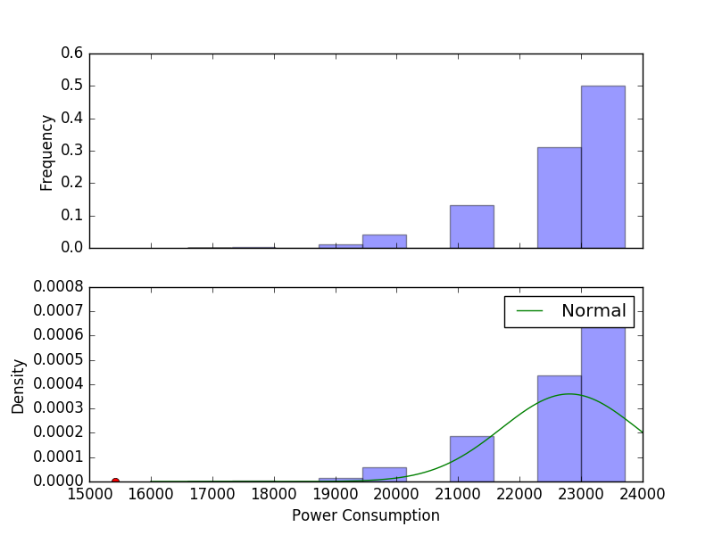
Histogram of the random solutions when k = 4 (N=16)
Mean = 22422.8743, Std. Dev. = 1344.71398

Slide 18
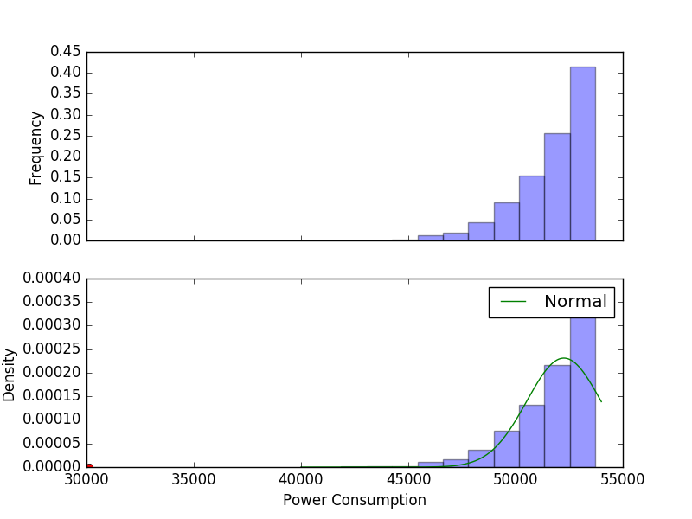
Histogram of the random solutions when k = 6 (N=54)
Mean = 52253.6880, Std. Dev = 1726.90373

Slide 19
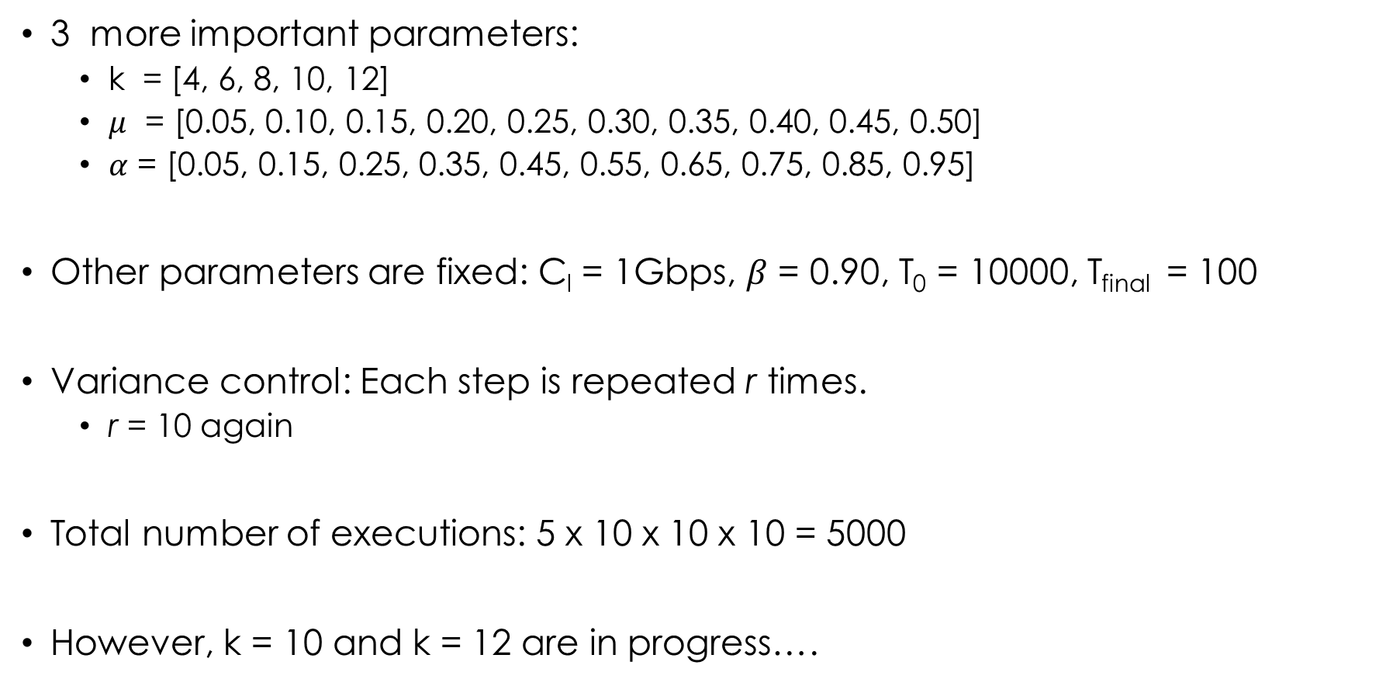
PHASE II
3 more important parameters:
k = [4, 6, 8, 10, 12]
$μ$ = [0.05, 0.10, 0.15, 0.20, 0.25, 0.30, 0.35, 0.40, 0.45, 0.50]
$α$ = [0.05, 0.15, 0.25, 0.35, 0.45, 0.55, 0.65, 0.75, 0.85, 0.95]
Other parameters are fixed: C_{l} = 1Gbps, $β$ = 0.90, T₀ = 10000, T_{final} = 100
Variance control: Each step is repeated r times.
r = 10 again
Total number of executions: 5 x 10 x 10 x 10 = 5000
However, k = 10 and k = 12 are in progress….

Slide 20
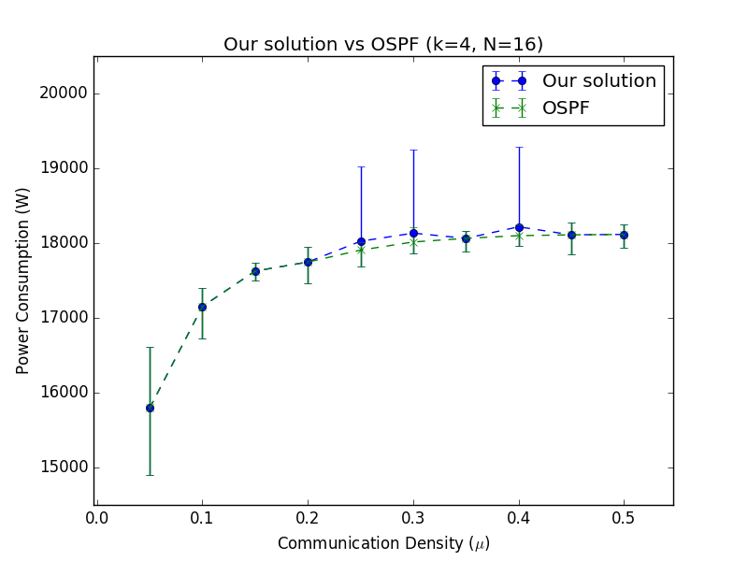
Our solution vs OSPF when k = 4 (N = 16)

Slide 21
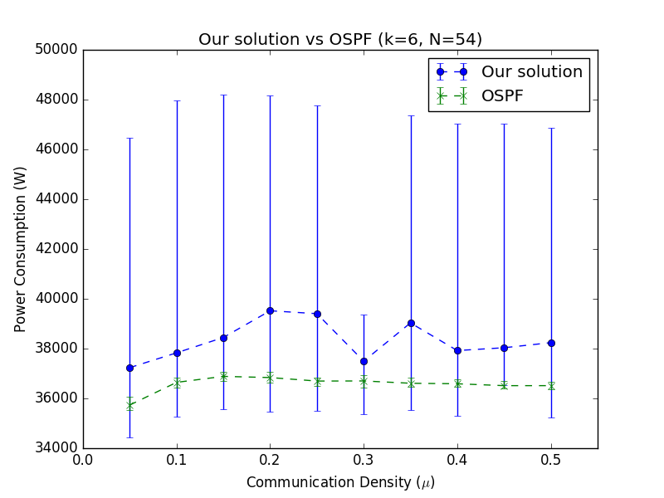
Our solution vs OSPF when k = 6 (N = 54)

Slide 22
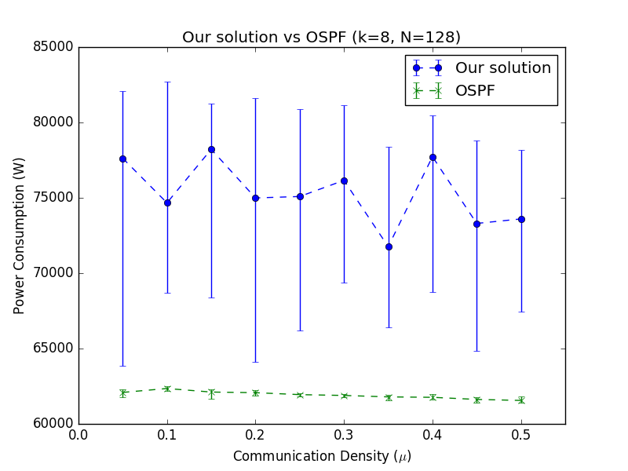
Our solution vs OSPF when k = 8 (N = 128)

Slide 23
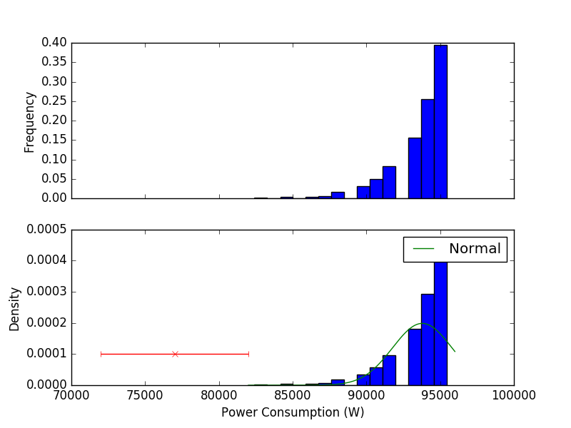
Histogram of the random solutions when k = 8 (N=128)
Mean = 93786.9041, Std. Dev = 2009.16740

Slide 24
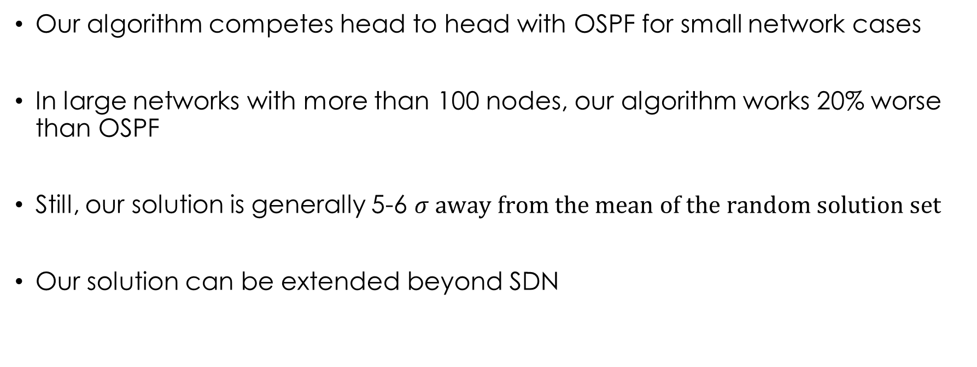
Conclusion
Our algorithm competes head to head with OSPF for small network cases
In large networks with more than 100 nodes, our algorithm works 20% worse than OSPF
Still, our solution is generally 5-6 $σ away from the mean of the random solution set$
Our solution can be extended beyond SDN

Slide 25
References
[1] D. Kreutz et al., “Software-defined networking: A comprehensive survey,” Proc. IEEE, vol. 103, no. 1, pp. 14–76, Jan. 2015
[2] B. Heller, S. Seetharaman, P. Mahadevan, Y. Yiakoumis, P. Sharma,S. Banerjee, and N. McKeown, “Elastictree: Saving energy in datacenter networks,” inProceedings of the 7th USENIX Conferenceon Networked Systems Design and Implementation, ser. NSDI’10.Berkeley, CA, USA: USENIX Association, 2010, pp. 17–17. [Online].Available: http://dl.acm.org/citation.cfm?id=1855711.185572
[3] X. Wang, X. Wang, K. Zheng, Y. Yao, and Q. Cao, “Correlation-awaretraffic consolidation for power optimization of data center networks,”IEEE Trans. Parallel Distrib. Syst., vol. 27, no. 4, pp. 992–1006, 2016.[Online]. Available: http://dx.doi.org/10.1109/TPDS.2015.242149
[4] R. Bolla, R. Bruschi, F. Davoli, and C. Lombardo, “Fine-grained energy-efficient consolidation in sdn networks and devices,”Network and ServiceManagement, IEEE Transactions on, vol. 12, no. 2, pp. 132–145, 201
[5] https://upload.wikimedia.org/wikipedia/commons/d/d5/Hill_Climbing_with_Simulated_Annealing.gif
[6] Coltun, R.; D. Ferguson; J Moy; A. Lindem (July 2008). "OSPF for IPv6". The Internet Society. OSPFv3. Retrieved 2008-07-23

Slide 26
Thank you for listening ☺

